Slide 1
Mini Motivational Interviewing in the 10 minute consultation
Dr Ramesh Mehay, www.bradfordvts.co.uk

Slide 2
INTRO
The foundations & theory

Slide 3
What are we going to do today?
Understand the philosophy behind MI
Recognise the specific skills required for MI
Demonstrate & apply MI skills to ANY general 10 minute consultation
See the value MI skills provide & what you have been missing out on.

Slide 4
What do you think it is?
Chat box
Poll 1 – use of MI survey https://tinyurl.com/mipoll01
Poll 2 – words to describe MI https://tinyurl.com/mipoll02

Slide 5
What MI is not
https://www.youtube.com/watch?v=-Bx7SowKtvA
Authoritarian ordering or directing
Warning or threatening.
Unsolicited/Premature suggestions/solutions
Persuading with logic, arguing, or lecturing.
Moralizing, preaching, or telling patients their duty.
Judging, criticizing, disagreeing, or blaming.
Unsolicited agreeing, approving, or praising.
Shaming, ridiculing, labeling, or name-calling.
Own oracular interpretations - hidden analytical meaning (oracular = like an oracle)
Reassuring, sympathizing, or consoling.
Intensive questioning or probing.
Withdrawing, distracting, humoring, or changing the subject.

Slide 6

MI - what it is
Changing lives
Resolve Ambivalence: “Should I or Shouldn’t I?”
Examples….

Slide 7
Why is it important
Telling doesn’t work that well (25%)
Look at prescriptions
Is there a better way?
MI – evidence based, cross cultural

Slide 8
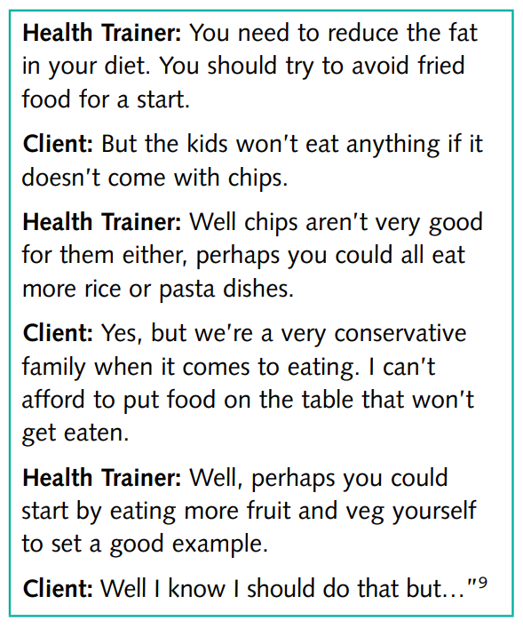
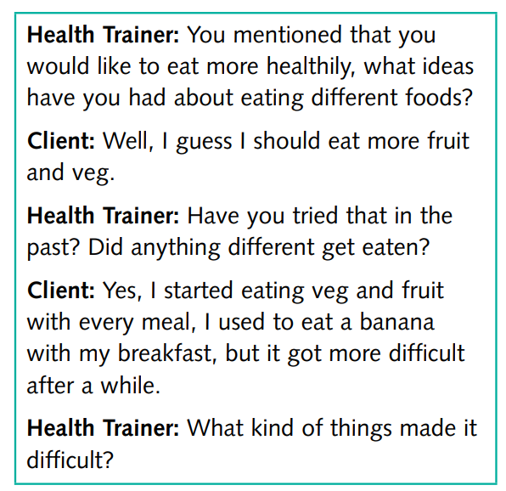

Slide 9
Traditional Approach | MI approach
Doctor does most of the talking | Patient does most of the talking
Patient is expected to listen | Doctor is expected to listen
Help patient understand what the doctor is thinking they should do | Help patient understand their own motivation for change
Doctor is the expert of advice | Patient is the expert of their personal circumstances
Power dynamics – doctor is in charge | Power dynamics – patient is in charge
Doctor = expert; Patient = recipient | Doctor & Patient = partnership

Slide 10
Philosophy of MI (Spirit)
Promote Collaboration – rather than confront or dictate
Enhance Autonomy – rather than your authority
Evoke – draw out rather than impose your ideas
Compassion
Additions by me…
Empathy
Respect
Genuine Interest
Empathy is when you feel what someone else feels alone.
Compassion is an emotion that causes you to feel what someone else feels and want to relieve their suffering. Compassion involves

Slide 11
Prerequisites required from you
Every bad habit was once a solution to a problem
People are generally better persuaded by the reasons which they have themselves discovered than by those which have come into the mind of others.” Blaise Pascal in Pascal Pensées, #10, 1660
The Michaelangelo Effect
The song you are singing in the consultation is the patient’s song – not your song.
Dance with the patient, not wrestle. No pull/pushing.
Promote self-efficacy. Nurture hope and optimism.
you are less the problem-solver who figures things out, and more the guide.
Provide Paternal Scaffolding.
Develop shared management plans
Stop seeing resistance, denial and a low readiness to change as poor patient traits.
Don’t be disappointed by relapse.
Don’t do it all in one go.

Slide 12
Diclemente & Prochaska
Premature
way out
Transtheoretical model 1983
Contemplation
Active change
START
Explore health belief
and establish readiness
for change
Precontemplation
Maintenance
Relapse
OPTIMAL RECOVERY
Change consolidated

Slide 13
Diclemente & Prochaska
Precontemplation
I’m okay as I am doc. Thanks but no thanks.
And please don’t talk about my smoking, I’m fed up of it.
“Don’t get me wrong doctor, I want to change but now aint a good time”
“I know I should, but it’s difficult”
“I know I need to quit smoking, but I’ve tried so many times and it’s just too hard. There’s just no point.”
Contemplation
“I do wanna stop because I know smoking is real bad for my health. But I’m so stressed at the moment and I feel I can’t cope without them.”
“To be honest, I should start a diet straight away. I mean, look at the size of me. At this rate, it’s no wonder I got no energy and feel crap. But I love my food and it makes me feel very happy when I eat”.
“I know I should take my medication every day, but I love my current care-free life and freedom.”

Slide 14
THE PROCESS
Behind Motivational Interviewing

Slide 15
What are we trying to do?
SUSTAIN TALK
to
AMBIVALENCE TALK
to
CHANGE TALK
You have to do this gently

Slide 16
Direct, Guide, Follow
You move repeatedly between three skills
Direct – Sometimes you have to teach, instruct, lead
Guide – explore, encourage, motivate
Follow – listen, understand, go with the flow

Slide 17
The 4 MI processes
https://www.youtube.com/watch?v=4Hrz9tLUlUw (great summary)
Engaging
Focusing
Evoking
Planning
Not linear
Back and forth between 2. and 3.

Slide 18
THE SKILLS
Necessary for Motivational Interviewing

Slide 19
OARS
Open Questions
Affirmations
Reflective Listening
Summarising

Slide 20
Open Questions
Do you take your medicines? (closed question)
Some patients find it difficult to keep on top of their medications and often end up missing doses. How do you find it? (open question + permissiveness when you anticipate truth anxiety)

Slide 21
Open Questions – let’s practise
And that make you feel bad?
How did that make you feel?
So, is are your eating habits bad at the moment?
How do you feel about your eating habits as they are at the moment?
Do you want to stop smoking?
What are your thoughts about stopping smoking?
So, do you think smoking is bad?
How does smoking affect your life at the moment?
Do you want to change your eating habits?
What would be the benefits of changing your eating habits?

Slide 22
Affirmations
Beef them up → Self-Efficacy
Statements (inflection)
Don’t bullshit
Natural points
“I’m impressed that you kept a diary. It really shows you are committed which is such a wonderful thing to see”

Slide 23
Affirmations - –let’s practise
It’s pointless. I mean last time I quit, after 2 years, I am back here.
Wow, at least you managed to do it before. I mean stopping smoking for 2 years is a long time.
I felt so low today I didn’t wanna come in.
It took a lot of courage for you to come in today.
You’re going to be disappointed in me. I fell off the bandwagon and had an alcohol binge all last weekend.
It took a lot of courage for you to come in today.
You’re going to be disappointed in me. I fell off the bandwagon and had a few smokes at the weekend.
“I appreciate your honesty sharing that you don't want to give up cigarettes.”
See what I mean doctor. There’s so much stressful things in my life. But one thing I have been doing is taking all my meds on time.
I'm impressed with your ability to take your medicine with all the other things you have going on in your life.
The best ones have a formula: state to good thing + the positive value you interpret

Slide 24
Reflective Listening
It is not just repeating back exactly what you heard.
Instead, it is a hypothesis testing approach to listening.
The formula is = paraphrase what they have told you + add in your hypothesis/interpretation#
Statements not questions (inflection)
Do lots of it.
Example
I want to start eating better. I really do. But I don’t know where to start.
You’re really keen on healthier eating but you feel overwhelmed and stuck. NOTE: absence of question mark
you get their story
build empathic connection
“As I hear myself talk, I learn my beliefs.” (as the patient hears what they have said externally from your voice). This solidifies their own convictions.
amplifies meaning or feeling if used strategically.
May lead the patient to yield more revelations.
All the above → better outcomes.

Slide 25
Reflective Listening
Simple
Paraphrase what they say
Amplified - Reflect on Change Talk to emphasise it….
“I really wand do this because doctor my lungs are in such a state and if I don’t do it now, it will be never!”
“So you feel now is the right time because it is blah blah blah”.
Double-Sided
On the one hand, but on the other….

Slide 26
Let’s practise
I’m not convinced that I have diabetes.
So you have some doubts about your diagnosis? Yeah because I feel fine and my mate who has diabetes has bouts of dizziness which I don’t.
I don’t like taking these medications because they make me feel terribly tired.
So, the side effects are putting you off from taking the medication. Yeah doc, unless you can find another one that is better.
I know I should be better at taking all these heart drugs but I keep forgetting – there’s so many of them.
It sounds like it’s challenging trying to take your medication on time.
I really do wanna stop because my lungs are getting rough and the extra money would help. But cigs help calm me down doc.
So, on the one hand you want to continue smoking because it calms you down but on the other hand you want to stop because you want to breathe better and save some money.
I really want to get this weight off and eat healthy. But when I get home I cant be bothered to eat healthily so I grab anything I can at that point.
So you would like to eat more healthily and you really do want to lose the weight but when you come get home you find it easier to grab whatever is there. What kind of things make it difficult for you.

Slide 27
One more
  I love my cigarettes and really am not one for wanting to stop.
  So it seems that you feel your okay as you are and perhaps never want to stop?
  Well not never. I mean, I know at some point it might harm my health so I wouldn’t say never.
  Mmmm…. What sorts of things worry you?
  You know lung cancer. But also, not breathing and getting really unfit and making me feel like I’m a slouch. And actually I cough all the time and clear lungs would be nice. But I find the damn things help me relax so much.
  Mmmmm so it sounds like on the one hand cigarettes really help settle you and that you want to carry on. But on the other hand you do have some significant health worries.

Slide 28
Summarise
Shows listening and understanding
helps you to the next part of the consultation e.g. what next. Moves towards ouput.
Example: So you said x, y and z. So where does that leave you now? OR So where do we go from here? OR So what’s the next step?
If I understand you correctly, you’ve been thinking of stopping smoking. There is a downside youre worried about how you will cope with all the stressful things in life. But on the other hand you want to have better breathing and live longer for your grandchildren and have some extra money.

Slide 29
LOOK OUT FOR CHANGE TALK
Gold dust → emphasize it. Reflect it.
Desire to change (want, like, wish)
  I wish I could exercise more often
Ability to change (can, could)
  I could walk around the block twice a day
Reasons to change (if, then)
  I know quitting now means my lungs have a chance to get better.
Need to change (need, have to, got to)
  I need to quit because it’s always causing arguments with my non-smoking husband

Slide 30
Providing Information
Elicit-provide-elicit
I do this all the time, whether there is change or no change.
Carefully time. Not early on.
Seek permission
Elicit
“What do you feel about that?”
Provide
“Mmmm, that’s interesting. Is it okay if I provide you a bit of information on that and see what you make of it?” or “Mmmm, that’s interesting. Is it okay if I share with you with the latest evidence in that area based on what the medical research tells us?”
Elicit
“So, having heard that, I’d be interesting to know about your thoughts and feelings”

Slide 31
Providing Information
  Elicit
    “What do you think about your smoking?”
    Well, Im in my 40s now and I suppose its too late all the damage has been done.
  Provide
    Thanks for sharing that with me. Is it okay for me to share some of the medical research says about that? (patient nods). Well it’s good news. The research says that even in your 40s, you can still prevent a lot of further lung damage happening. And that by the time youre in your 60s, you would definitely be in a better position than if you carried on.
  Elicit
    Now, having heard that, I’d be interested in hearing about your thoughts and feelings.
    Well, that’s interesting doc. I thought I would have been knackered now. So, there is a bit of a chance?
    Well, I think it’s more than just a bit. I see. Anyway, I’ll leave that information with you and that my door is always open if you want to talk more. Okay, let’s get back to xxx (dr trying not to be too pushy at this stage).

Slide 32
Rating Scales – importance & confidence
“On a scale of 1 to 10, how confident do you feel that you can achieve this goal? If 1 was not confident and 10 was very confident, what number would you be at?”
Mmm – why not a lower number?
(if it is a 5 or 6) - What would help you to be a higher number?

Slide 33
Cost-Benefit Analysis
This compares the costs and benefits of the behaviour change vs no behaviour change.
So, what positive things do you get if you continue smoking?
What are the disadvantages of continuing to smoke?
What are the positive things you get if you decide to stop smoking?
What are the disadvantages of stopping smoking?
On a scale of 1-10, how certain are you now that you want to stay the same?

Slide 34
BEWARE: Righting Reflex
When we tell people they are wrong – they become defensive. They push back.
It is a natural human tendency to resist persuasion.
If we tell them why to change, and they tell us why they shouldn’t..
The more we talk about why they shouldn’t do it = the more they talk about why they should do it

Slide 35
BEWARE: Righting Reflex
How to handle it…
Don’t rush to correct when you hear something that you feel is wrong.
Deep breath in – slow breath out – let it gooooooo.
Just explore – questions to help you understand, reflective listening and use silence.
It will soon die down.

Slide 36
BEWARE: Roll with Resistance
When patients resist or you feel friction
DO NOT FIGHT OR ADD FUEL TO THE FIRE
See it as a NORMAL reaction, don’t judge the patient on it.
Deep breath in
Roll with it
Explore…. Ask questions, Reflective Listening
It will soon fizzle out

Slide 37
THE LAST SLIDE
About Motivational Interviewing

Slide 38
Summary
There’s a lot of skills in MI that will not be new to you. You already have the skills like asking open questions. Skills you probably have but need tidying up are
Affirmations
Reflective Listening
Summarising
Using the confidence, commitment, readiness scales
Providing information via Elicit-Provide-Elicit
Rolling with Resistance when you see it

